Slide 1
Intro to Cloud Computing (Azure and General Perspective)
Shrinivasan Patnaikuni (P.S.R.Patnaik)
AWS Certified Solutions Architect
Microsoft Certified Specialist in Architecting Azure Solutions
Been consulting, developing for 10+ years in Cloud, AI, DevOps, BigData, IoT
Masters of CS Engineering, Pursuing Ph.D. In AI (NLP)

Slide 2
Learning outcomes
Learn about emerging technology cloud and how its going to change & benefit the software industry & its users.
Aware about major changes that they need to understand in their field & job due to emergence of cloud.
To know about different topologies which are available in over all Cloud solutions in marker as general & help decision makers & learners to understand what type of topology to select for their business needs.

Slide 3
Basics of Cloud Computing
Emergence of Cloud computing
The effect of Cloud on the Software Industry & Software users
The need of the Software Testing field to move to the Cloud

Slide 4
Cloud Computing
What is cloud computing?
Cloud Computing represents the next evolution in computing where shared resources are made available and accessed as a service over Internet, intranet, and/or dedicated network.

Slide 5
Definition
NIST defines Cloud Computing as follows: “Cloud Computing is a model for enabling convenient, on-demand network access to a shared pool of configurable computing resources (e.g., networks, servers, storage, applications, and services) that can be rapidly provisioned and released with minimal management effort or service provider interaction. This cloud model promotes availability and is composed of five essential characteristics, three service models, and four deployment models.”

Slide 6
Characteristics
On-demand self-service:
Broad network access:
Resource pooling:
Rapid elasticity:
Measured service:

Slide 7
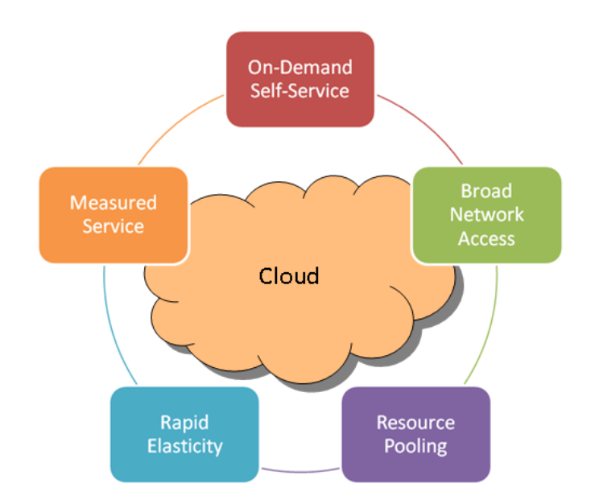

Slide 8
Characteristics
What should we expect to see from someone providing Cloud Computing services to us?
The answers will be different depending upon your viewpoint;
for example,whether you are a
Consumer
Provider
Developer

Slide 9
Consumer
Cloud Service Consumer – The cloud service consumer takes many forms, depending on the type of
offering. For example, the service consumer for an SaaS offering is consuming the application, while
the service consumer for an IaaS offering is consuming hosted virtual images. There are many
responsibilities for the cloud service consumer.

Slide 10
Provider
The cloud service provider hosts cloud services for cloud service
consumers. The type of hosted service depends on the cloud service model. For example, IaaS
providers make available hosted virtual infrastructure resources, whereas SaaS providers offer
application or software components as services.

Slide 11
Developer
The cloud service developer develops the cloud services that will be
consumed by the end customer. The type of service depends on the type of cloud service model
offered; it could be virtual images, multi-tenant applications, etc. Cloud service developers may also
integrate cloud services offered by other developers or providers. Cloud service developers may
themselves be consumers of platform or infrastructure cloud services.

Slide 12
Characteristic: On-demand self-service:
Consumer
Provider
Developer

Slide 13
Characteristic Broad network access
Consumer
Provider
Developer

Slide 14
Characteristic Resource pooling
Consumer
Provider
Developer

Slide 15
Characteristic Rapid elasticity
Consumer
Provider
Developer

Slide 16
Characteristic Measured service
Consumer
Provider
Developer

Slide 17
Service Delivery Models
IaaS
PaaS
SaaS

Slide 18
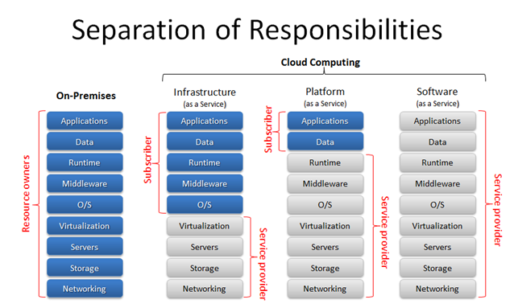

Slide 19
Deployment Models
Private
Public
Hybrid

Slide 20
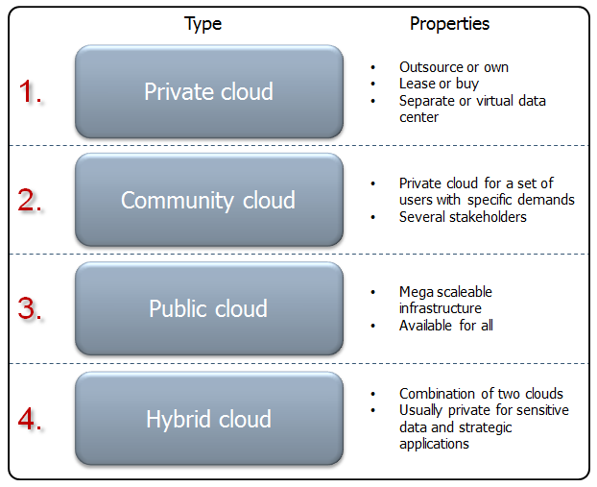

Slide 21
Traditional vs Cloud (Computing)

Slide 22
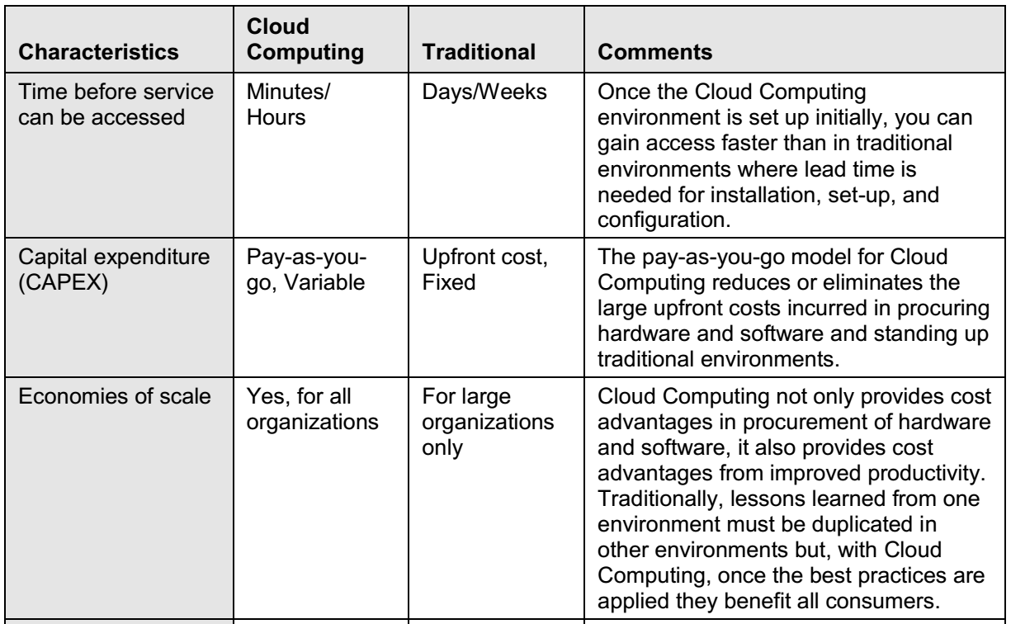

Slide 23
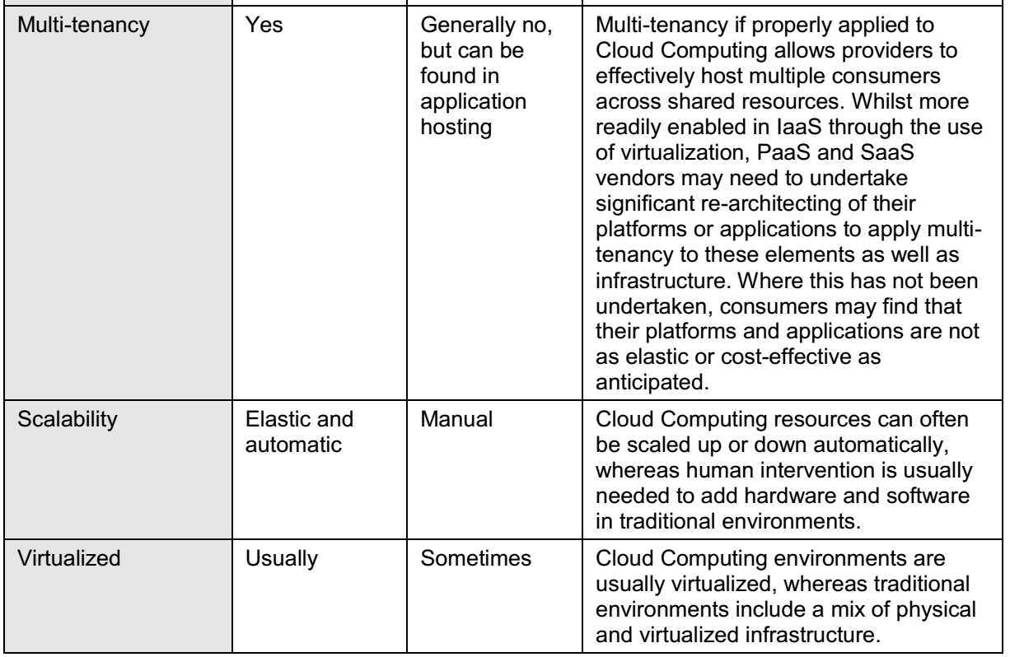

Slide 24
Benefits of Cloud Computing

Slide 25
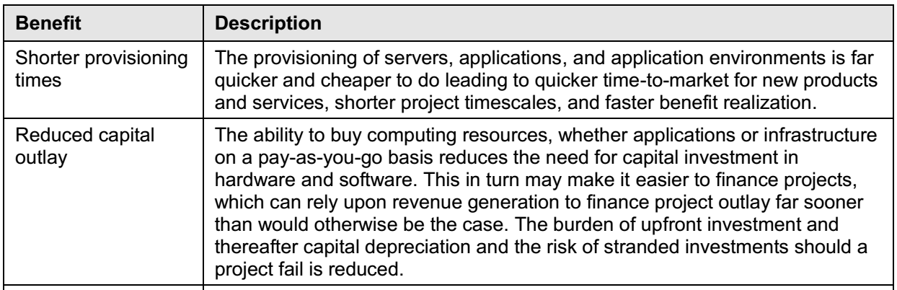

Slide 26
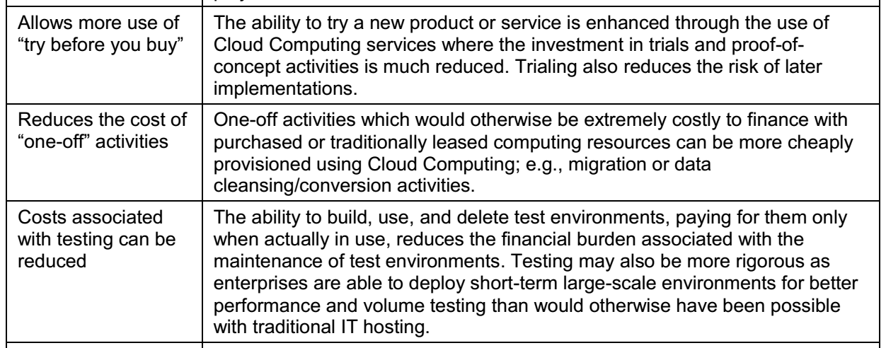

Slide 27
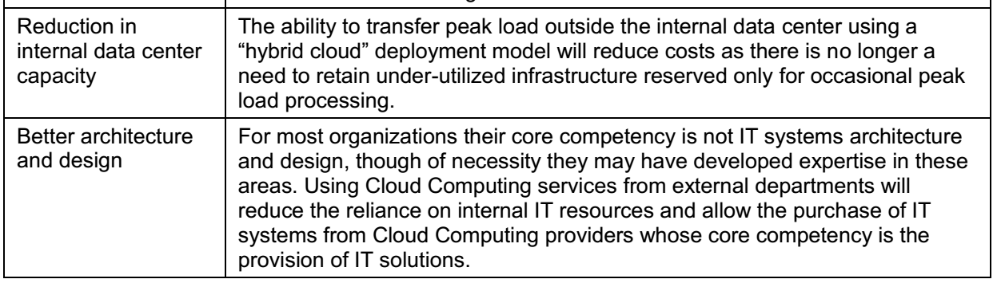

Slide 28
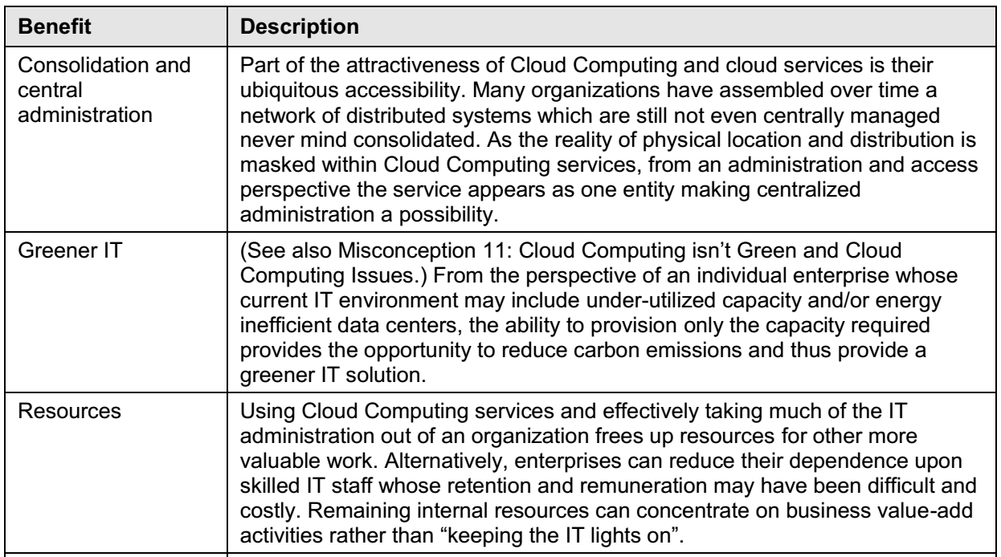

Slide 29
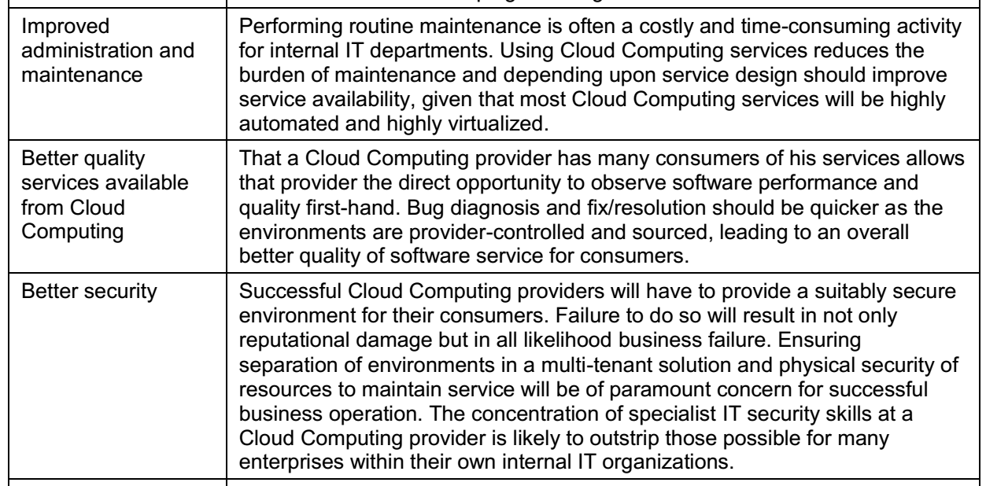

Slide 30
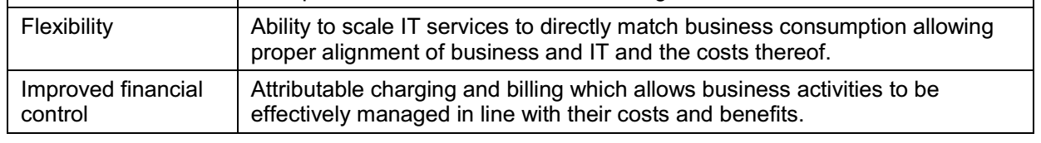

Slide 31
Issues

Slide 32
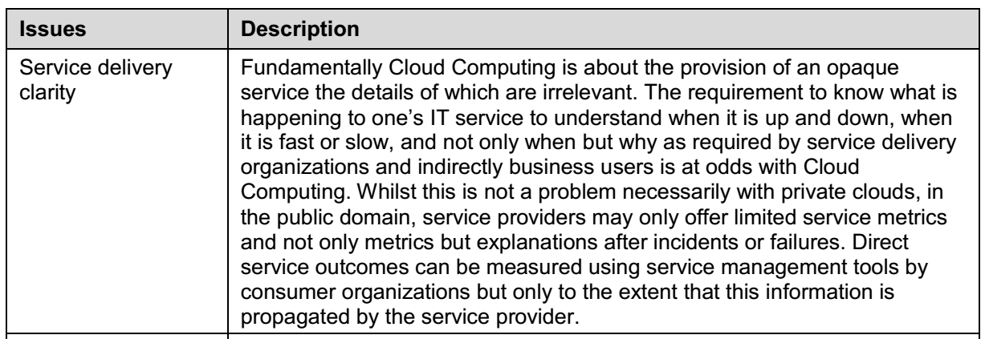

Slide 33
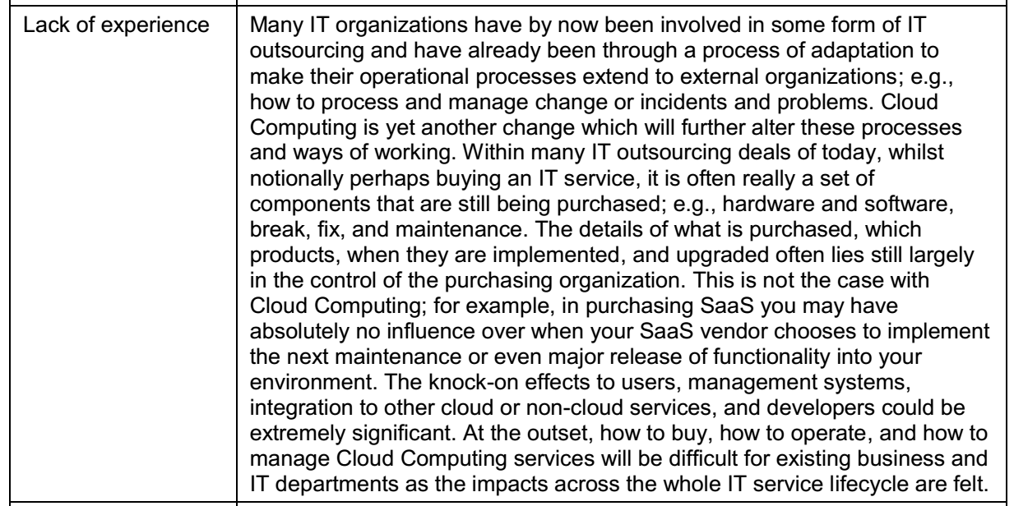

Slide 34
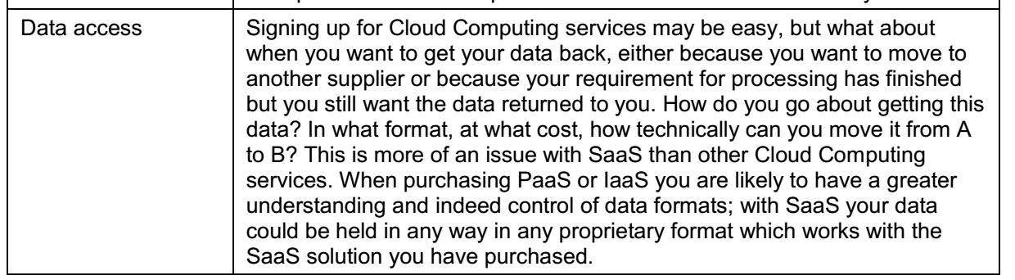

Slide 35
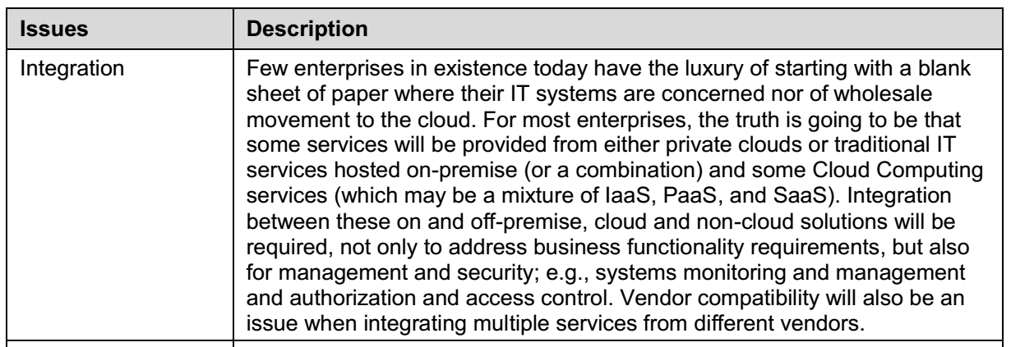

Slide 36
Misconceptions Regarding Cloud Computing
Misconception 1: IaaS/PaaS/SaaS
Misconception 2: Private Clouds Don’t Exist
Misconception 3: Multi-Tenancy is a Given in Cloud Computing

Slide 37
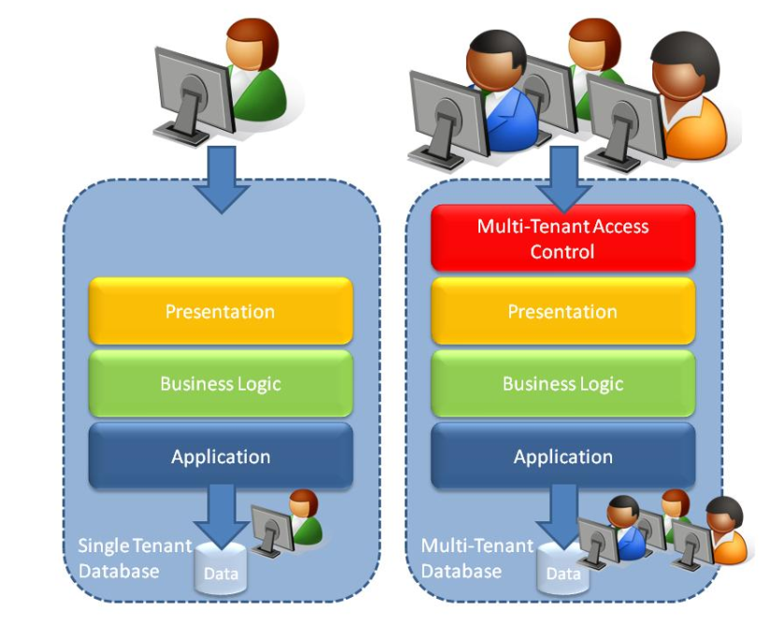
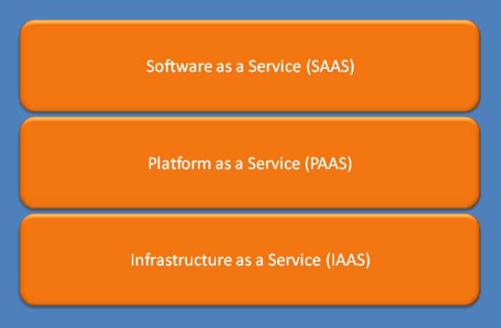

Slide 38
Misconceptions Regarding Cloud Computing
Misconception 4: Cloud Computing is Always Cheaper than an On-Premise Service
Misconception 5: Cloud Computing is just Virtualization by Another Name
Misconception 6: Cloud Computing is a new name for Utility Computing or
Grid Computing

Slide 39
Misconceptions Regarding Cloud Computing
Misconception 7: Everything as a Service (XaaS)
Misconception 8: Using Cloud Computing means No More Architecture and
Infrastructure Design

Slide 40
Misconception 9: Cloud Computing is about the Provision of IT Infrastructure
Misconception 10: Cloud Computing is Just Outsourcing Re-Packaged
Misconception 11: Cloud Computing isn’t Green

Slide 41
Cloud and conventional methods of Computing (Testing Landscape)
Software Build Generation
Build Deployment
Data bed preparation
Functional Testing
Non functional Testing

Slide 42
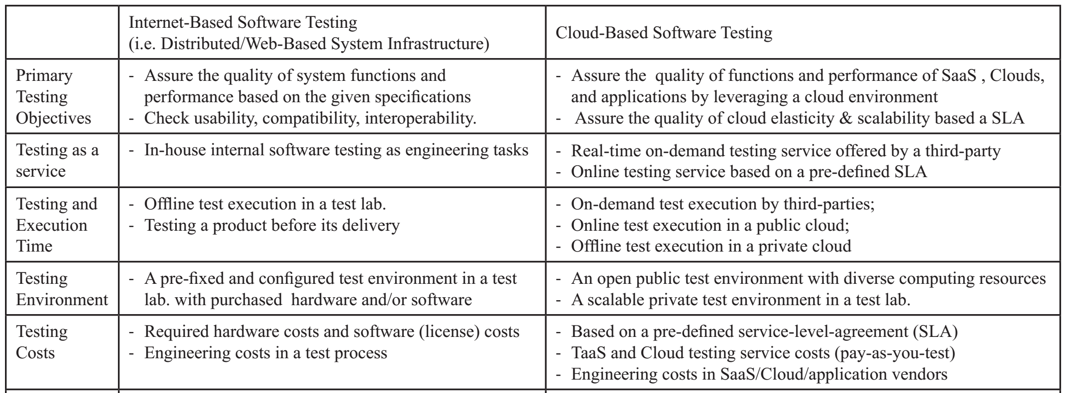

Slide 43
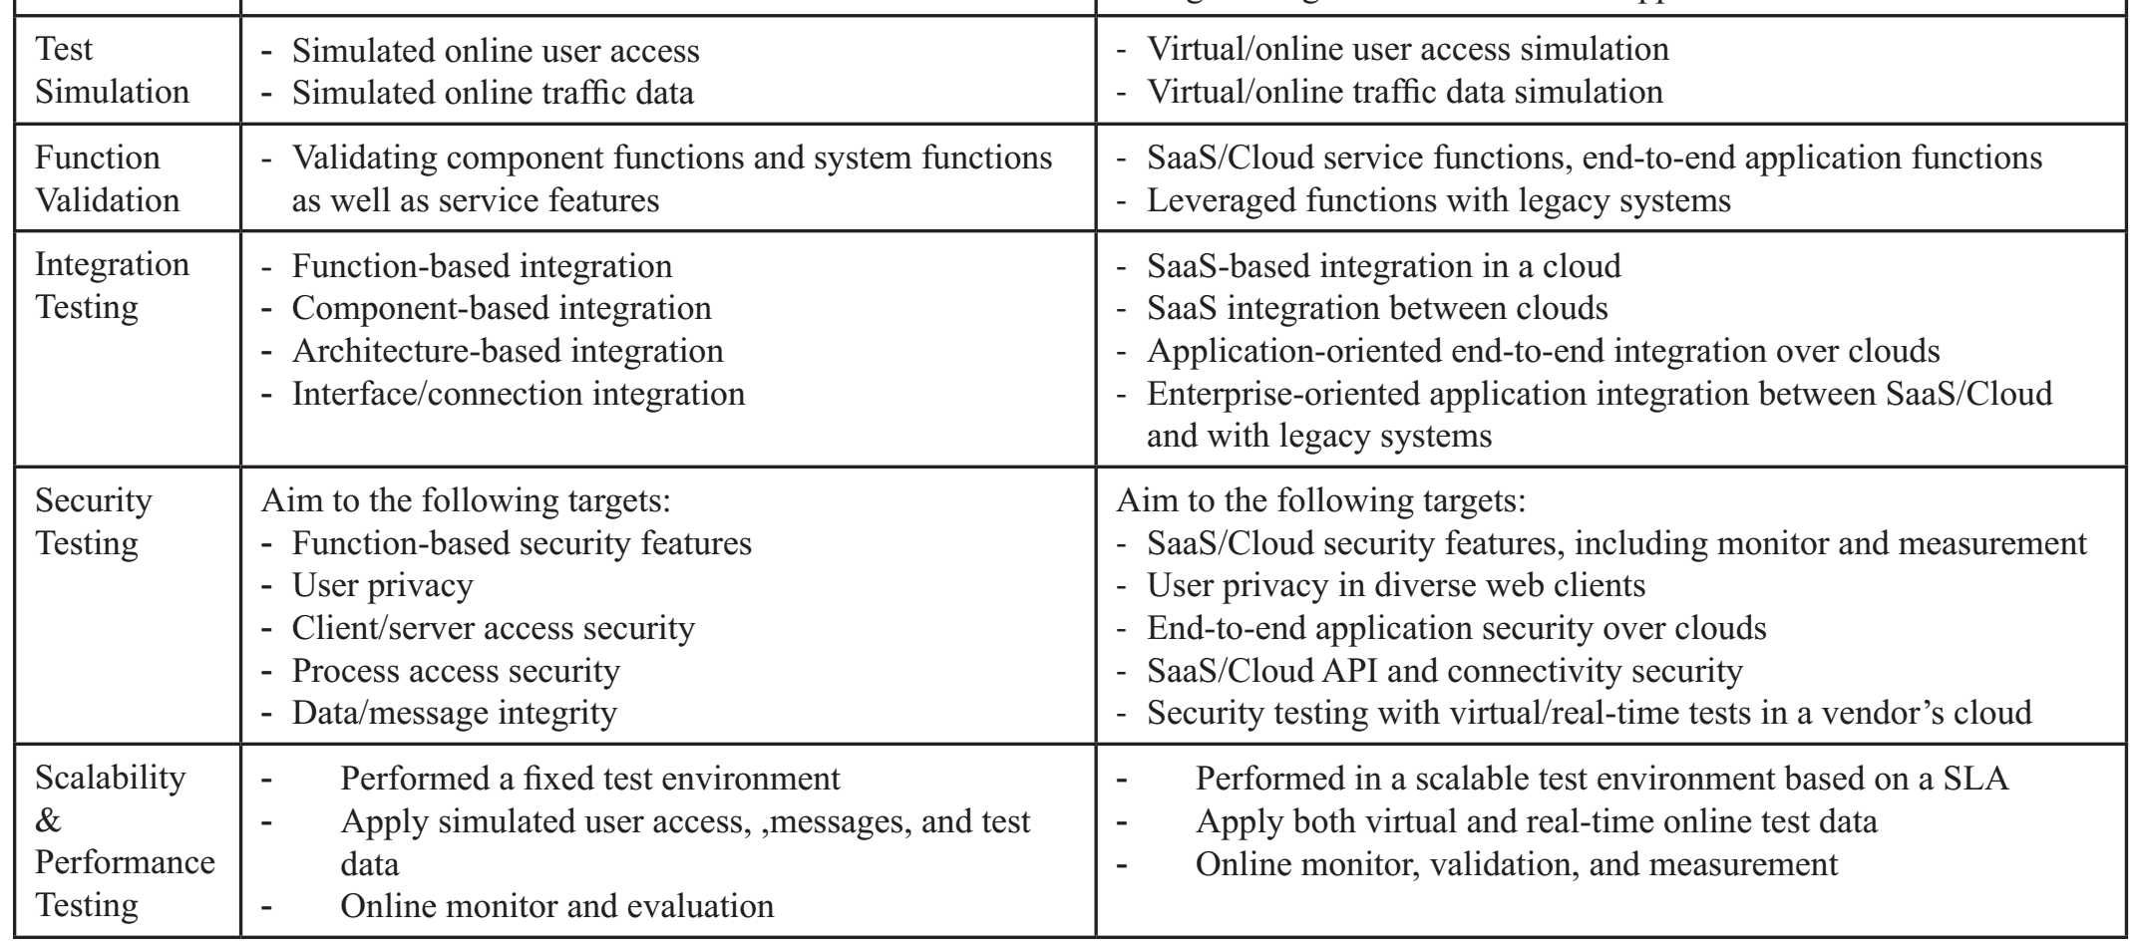

Slide 44
(QnA)

